Slide 1
In the spirit of Job 38 to 42, we offer our hard-working MCUSA executive leadership our prayers and a whirlwind holiday in the natural world.

Slide 2
You are here.
O’Hare Airport
Right now, you are in the Desplaines River Watershed. A watershed is an area of land that drains into a given river. Everyone lives in a watershed and everyone contributes to the health of the watershed.

Slide 3
The Desplaines River runs through a strip of forest preserve known as the Schiller Woods, about 2 miles west of you.

Slide 4
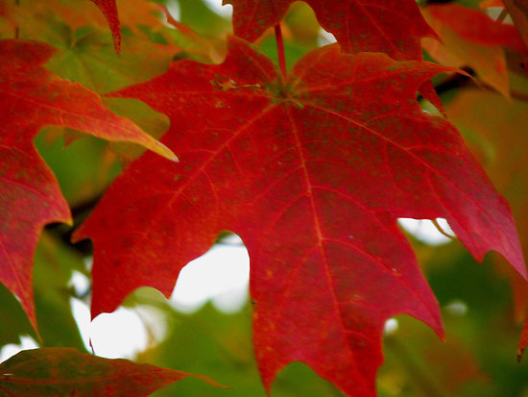
Red maples and sycamores grow along the river.

Slide 5
It is a good place to fish for Northern Pike.

Slide 6
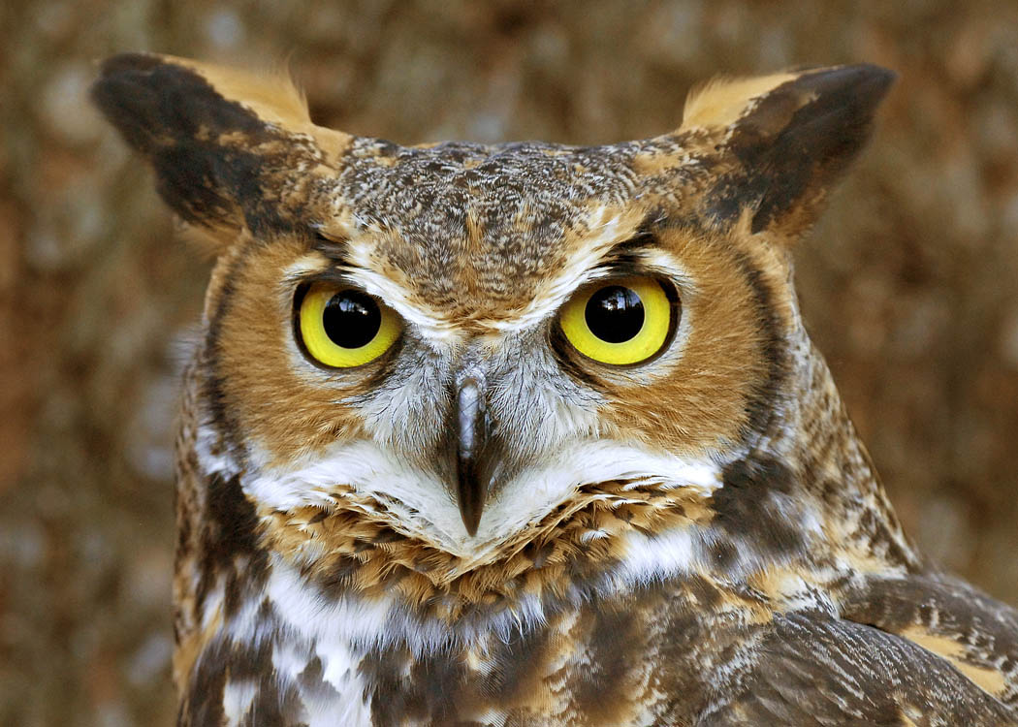
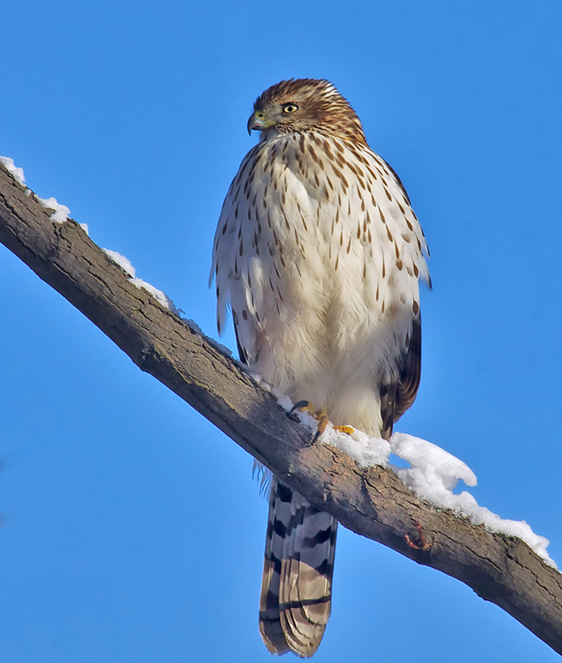
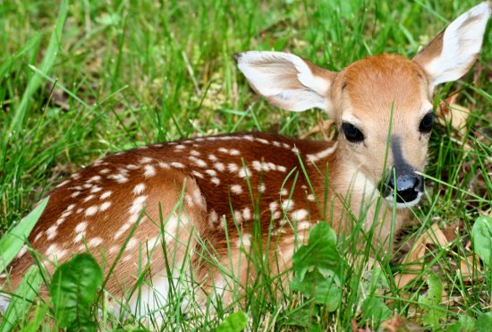
You can see Cooper’s Hawks and Great- Horned Owls along the Desplaines River. Also many deer.

Slide 7
Fun Fact: Two miles directly east of you, in Schiller Park, is an outdoor hand pump that draws water from an aquifer that has a unique mineral content and taste. The pump is in constant use, as people fill large containers to take home. It is particularly popular among Polish people, who say it tastes like the water of their homeland. Some even say it is a fountain of youth.

Slide 8
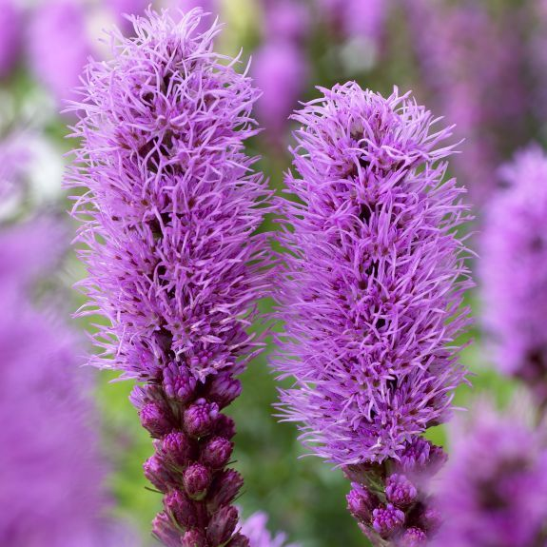
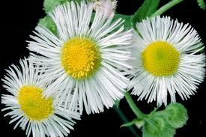
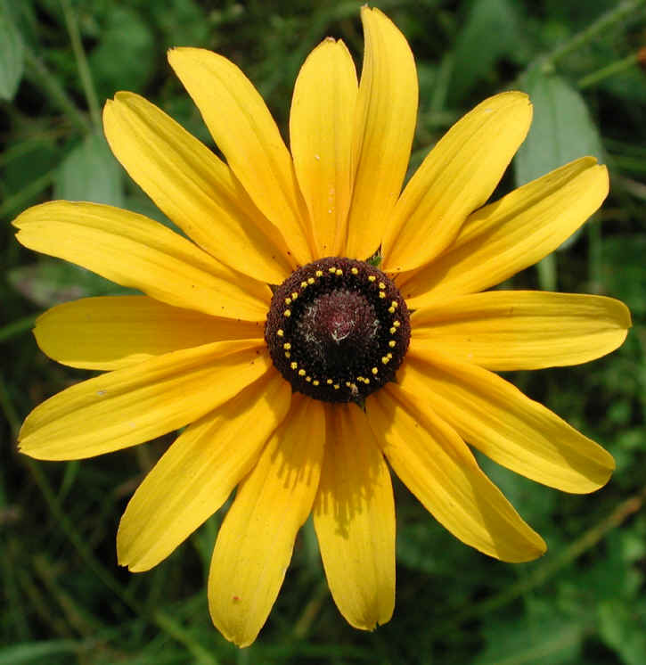
Lastly, we send you a virtual bouquet of wildflowers native to this region.
Butterfly Weed
Blazing Star
Flea Bane
Black-eyed Susan

Slide 9
Brought to you by Mennonite Creation Care Network.

